Slide 1


2022-23

Slide 2

Resolved: Humans are primarily driven by self-interest.
Primarily: Of Majority influence.
Self-interest- Moral and psychological concept denoting a focus on the betterment of the individual.
At its core, this debate is on egoism vs altruism.

Slide 3

Egoism
Selfishness is extolled as a virtue
Ayn Rand, The Virtue of Selfishness

Slide 4
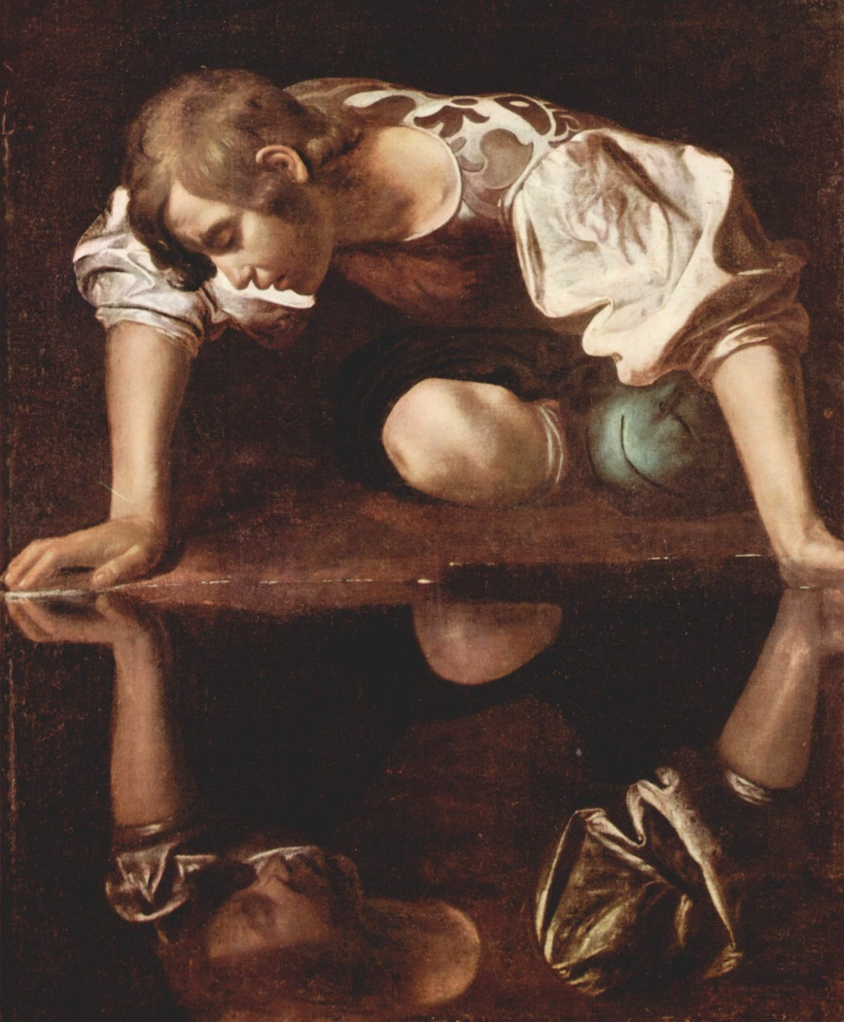
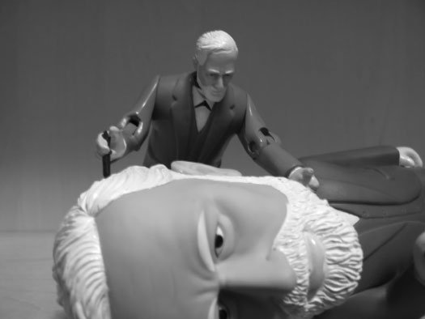
Psychological Egoism
Often confused with ethical egoism, yet quite distinct—because it is not a moral theory.
Psychological egoism is a theory of human psychology and asserts that each person does in fact pursue his or her own self-interest alone.

Slide 5
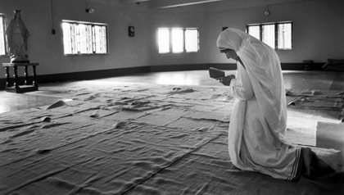
The Argument: We Always Do What Makes Us Feel Good
So-called altruistic actions produce a sense of self-satisfaction in the person who performs them.
People sometimes seem to act altruistically, but it is not hard to discover that the ‘unselfish’ behavior is actually connected to some benefit for the person who does it.
Mother Teresa’s actions, for example, were motivated by the belief she would be handsomely rewarded in heaven.

Slide 6


The Argument: We Always Do What Makes Us Feel Good
This argument is likewise badly flawed.
The fact that one has a self-interested motive doesn’t mean that one doesn’t have benevolent motives as well.
If I see a child drowning, my desire to help that child will usually be greater than my desire to avoid a guilty conscience.

Slide 7
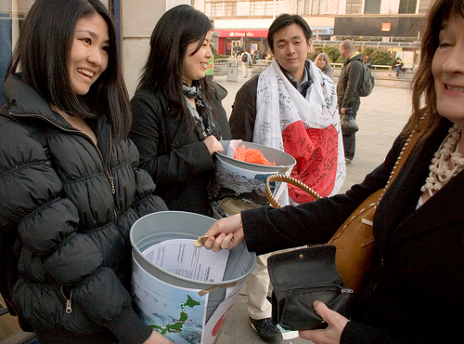
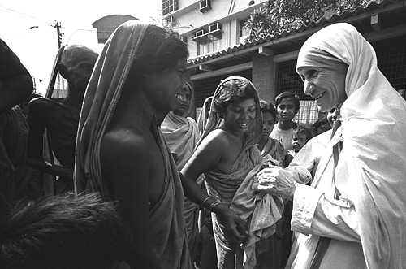
The Argument: We Always Do What Makes Us Feel Good
We may derive satisfaction from getting what we desire, but the object of our desire is not usually the feeling of satisfaction itself.
Our desire to help others often comes first; the good feelings we may get are merely a by-product.

Slide 8
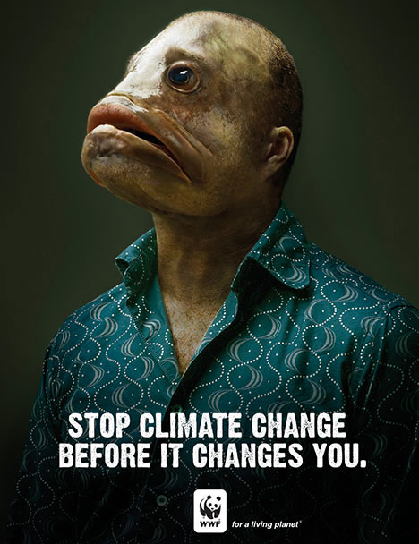
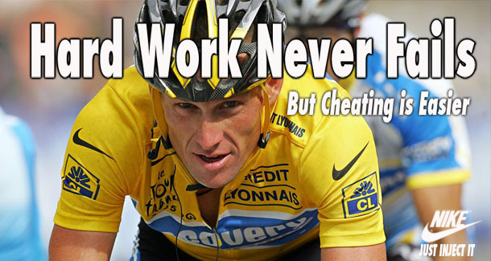
Ethical Egoism
Ethical egoism is the radical idea that the principle of self-interest accounts for all of one’s moral obligations.
Sometimes one’s interests may happen to coincide with the interests of others—in that by helping oneself, one will coincidentally help them, too.
However, the benefit to others is not what makes an action right. An action is right only insofar as it is to one’s own ‘advantage.’

Slide 9
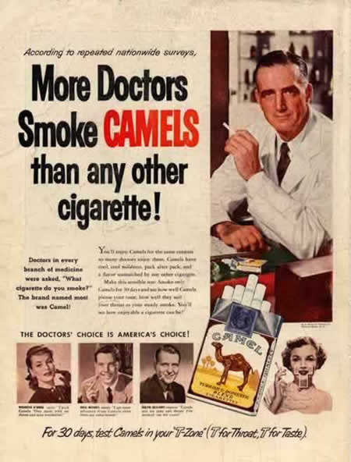

Ethical Egoism
One should not, however, always do what one wants to do (for example, set up a meth lab).
A person ought to do what really is in his or her best interests, over the long run.

Slide 10
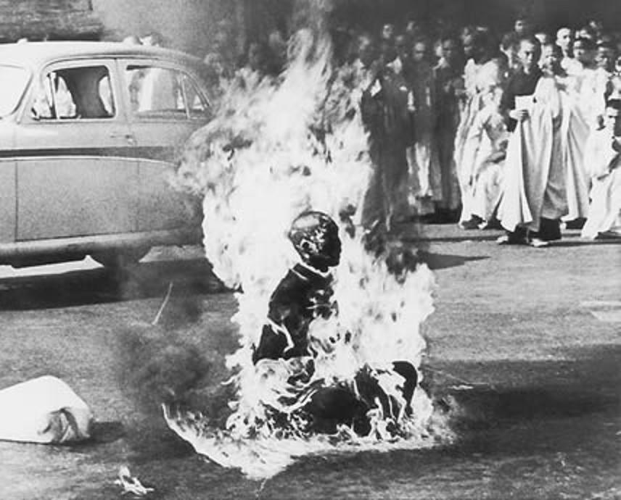
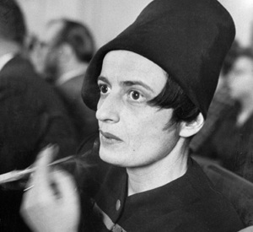
Ayn Rand’s Argument
Ethical egoism is associated with Ayn Rand (1905-1982) more than with any other 20th Century writer.
Altruism, according to Rand, leads to a denial of the value of the individual (and his projects and goods).
“If a man accepts the ethics of altruism, his first concern is not how to live his life, but how to sacrifice it.”

Slide 11

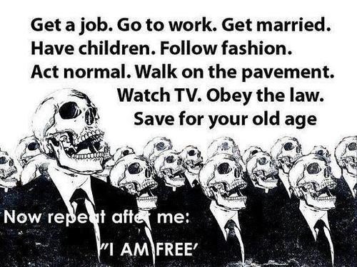
Ayn Rand’s Argument
The argument is:
Each person has one life to live AND altruism rejects the value of the individual.
THEREFORE ethical egoism views the individual’s life as having supreme value, ethical egoism is the moral philosophy we ought to accept.

Slide 12
Versions of Ethical Egoism
Personal Ethical Egoism
“I am going to act only in my own interest, and everyone else can do whatever they want.”
Individual Ethical Egoism
“Everyone should act in my own interest.”
Universal Ethical Egoism
“Each individual should act in his or her own self interest.”

Slide 13
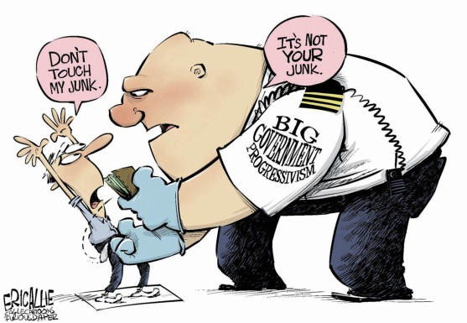
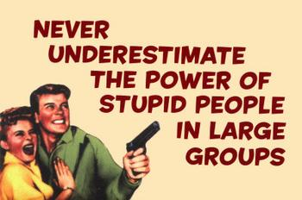
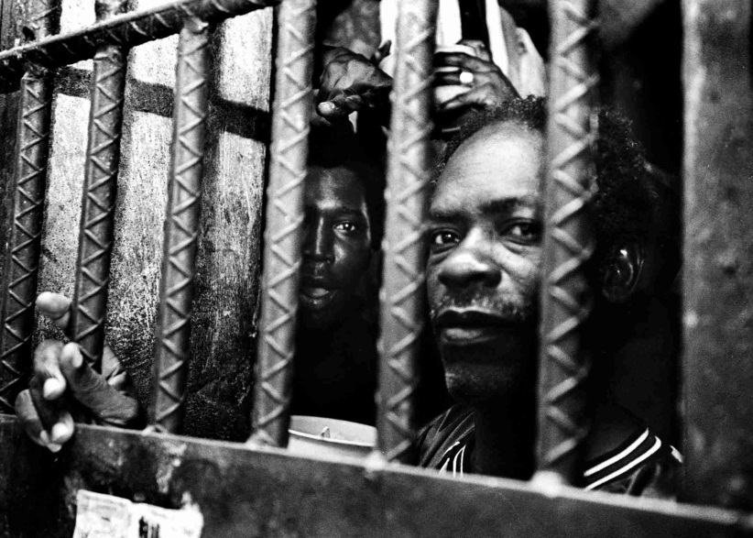
Compatible with Commonsense Morality
Ethical egoism claims that all our commonsense moral views regarding duties are ultimately derived from the one fundamental principle of self-interest.
It is to our own advantage to avoid harming others. Otherwise, they might harm us.
It is to our own advantage to be truthful. Otherwise, others may be dishonest to us.
It is to our own advantage to keep our promises. Otherwise, others may break their promises to us.

Slide 14
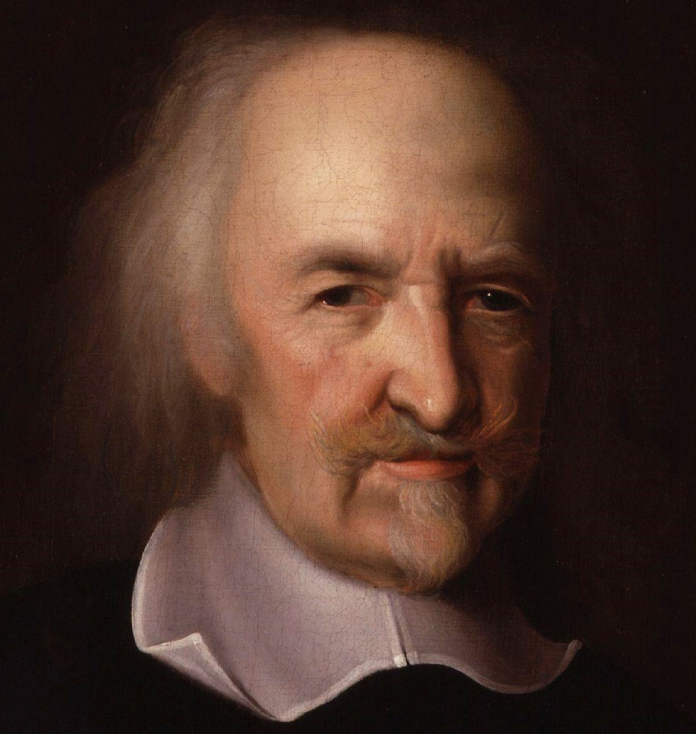
Commonsense Negative Duties
Thomas Hobbes (1588-1679) used this line of reasoning.
Hobbes formulated a negative version of the Golden Rule:
“Do not that to another, which thou wouldst not have done to thyself.”

Slide 15
Ethical Egoism and ‘Wickedness’
Suppose that someone could actually ‘benefit’ by doing things we construe as ‘wicked.’ For example:
Feeding a baby poison to fake a lawsuit for money.
Robbing a bank go to prison rather than to become homeless.
Wouldn’t ethical egoism have to approve of such actions?

Slide 16
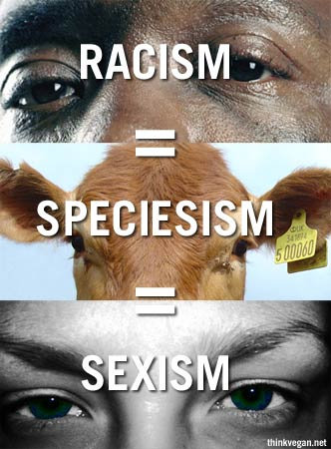
Unacceptably Arbitrary
Ethical egoism is a moral theory of the same type as racism, sexism, etc.
It advocates that each of us divide the world into two categories. The interests of one group (ourselves) are more important than those of the second group (everyone else).
But ask: What makes me so special? What justifies placing myself in the special category?
Failing to provide an answer, ethical egoism is as arbitrary as racism.

Slide 17
Arguments for Ethical Egoism
There are at least three principal arguments in support of ethical egoism:
Altruism is demeaning.
Acting selfishly creates a better world.
It doesn't result in such a different world after all.

Slide 18
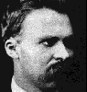
Altruism Is Demeaning
Friedrich Nietzsche and other philosophers argued that altruism was demeaning because it meant that an individual was saying that some other person was more important than that individual. Nietzsche saw this as denigrating oneself, putting oneself down by valuing oneself less than the other. This, the heart of altruism, is demeaning in Nietzsche’s eyes.

Slide 19

Acting Selfishly Creates a Better World
Ethical egoists sometimes maintain that if each person took care of himself/herself, the overall effect would be to make the world a better place for everyone.
Epistemological: Each person is best suited to know his or her own best interests.
Moral: Helping others makes them dependent, which ultimately harms them.

Slide 20

Ethical egoism doesn’t result in such a different world after all.
This argument presupposes the people in fact already act selfishly (i.e., psychological egoism) and are just pretending to be altruistic.
If psychological egoism is true, then we should admit its truth and get rid of our hypocrisy.
Rebuttal: it may not make a big difference in a world of independent adults, but in a world with children and people at risk or in need, they would be put in further jeopardy.

Slide 21

Criticisms of Ethical Egoism
Cannot be consistently universalized
But see Kalin: This works in sports.
Presupposes a world of strangers indifferent to one another.
Difficult to imagine love or even friendship from the altruist’s standpoint.
Seems to be morally insensitive

Slide 22

Universalizing Ethical Egoism
Can the ethical egoist consistently will that everyone else follow the tenets of ethical egoism?
It seems to be in one’s self-interest to be selfish oneself and yet get everyone else to act altruistically (especially if they act for your benefit). This leads to individual ethical egoism.
Some philosophers such as Jesse Kalin have argued that in sports we consistently universalize ethical egoism: we intend to win, but we want our opponents to try as hard as they can!

Slide 23

Ethical Egoism: a philosophy for a world of strangers
Some philosophers have argued that ethical egoism is, at best, appropriate to living in a world of strangers that you do not care about.

Slide 24

Ethical Egoism and Friendship
Can ethical egoists be good friends?
If friendship involves (among other things) being concerned about other people for their own sake, then this seems something beyond the reach of the egoist.
Ethical egoists can help their friends if they believe there is a long-term payoff for doing so.

Slide 25
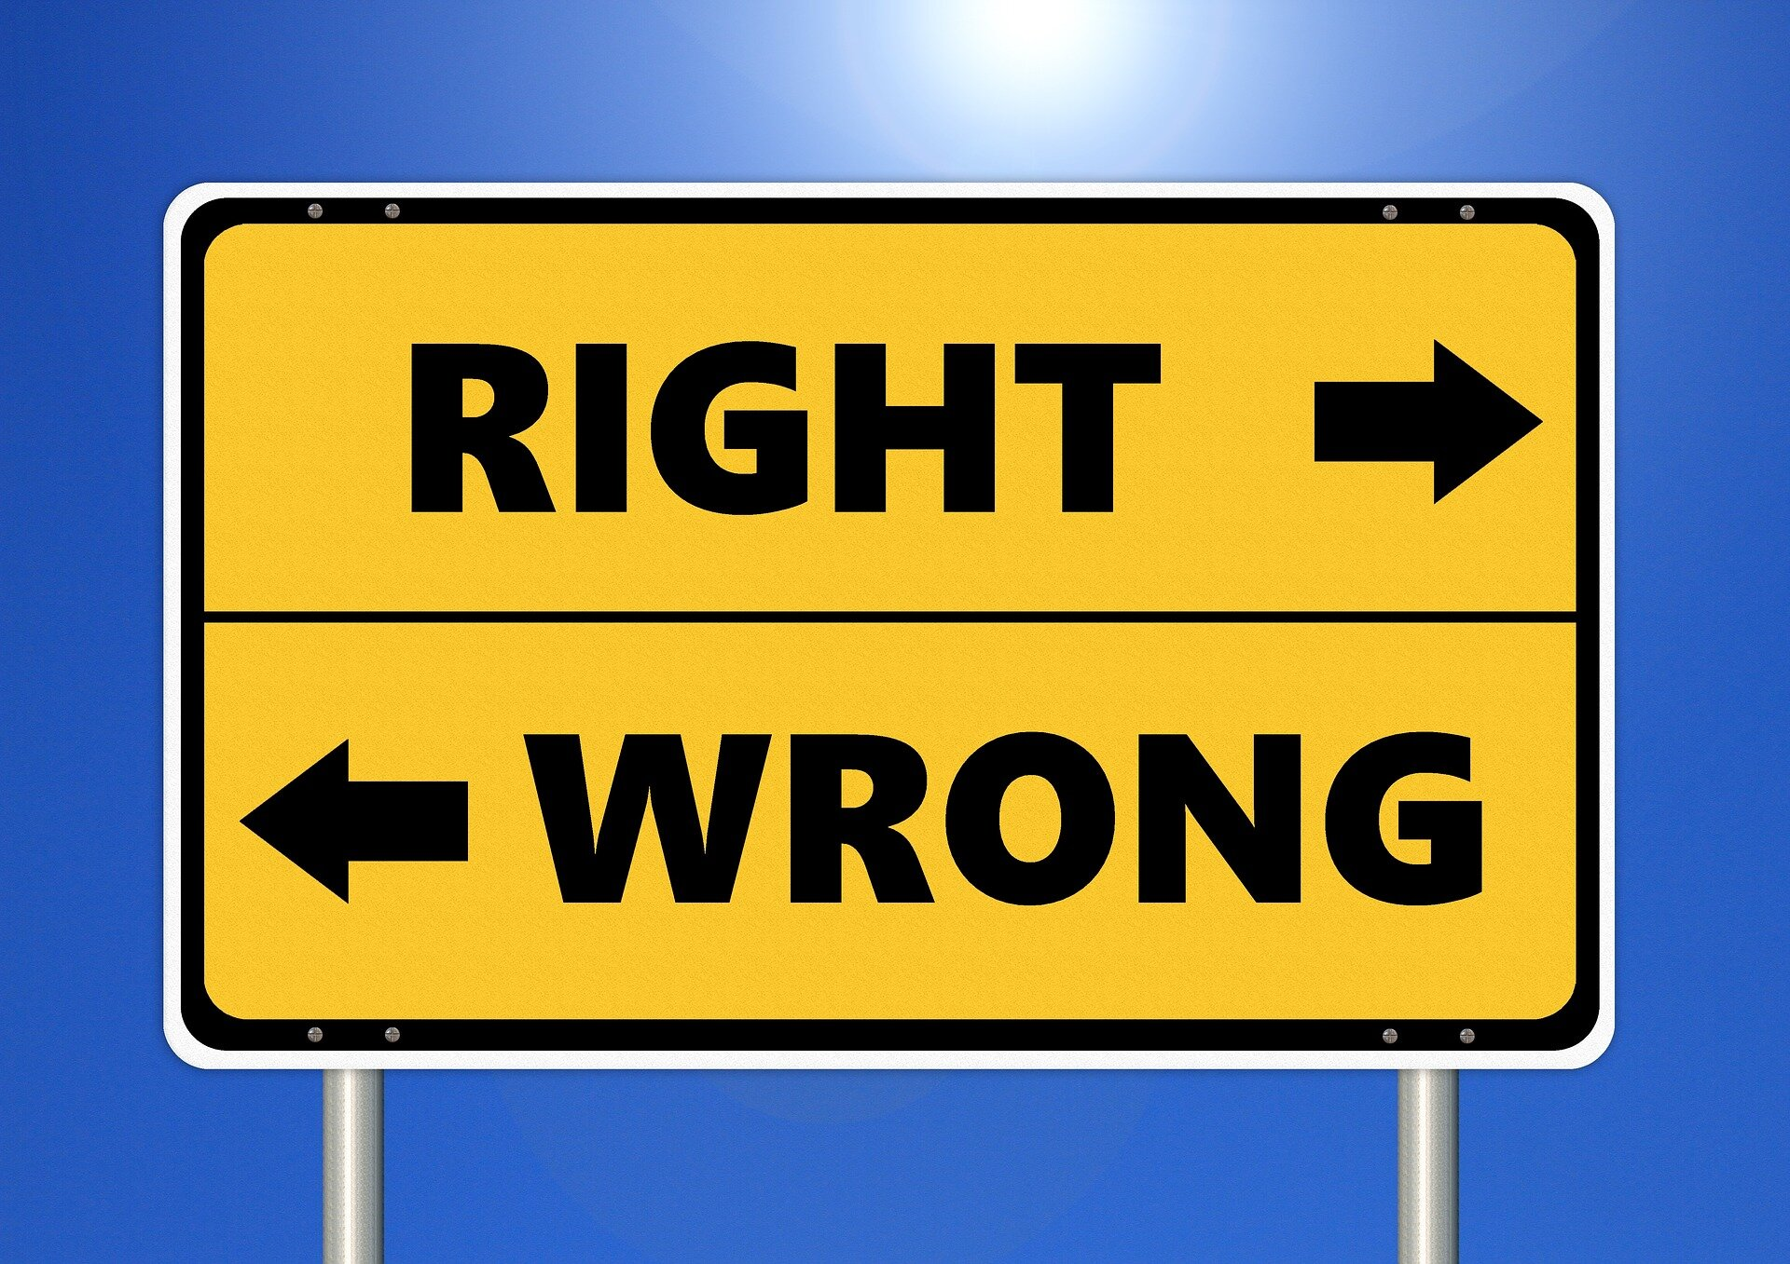
Ethical Egoism and Moral Sensitivity
Can the ethical egoist be sensitive to the suffering of others?
Such sensitivity seems to presuppose caring about other people for their own sake.
Moral sensitivity presupposes that the suffering of others exerts a moral “pull” on the individual—something that the ethical egoist does not recognize.

Slide 26

The Truths in Ethical Egoism
Sometimes self-interest masquerades as altruism
Ethics should not deny the importance of self-interest
Self-love is a virtue, but it is not the only virtue: ethical egoism mistakes a part of the picture for the whole picture

Slide 27
Egoism, Altruism, and the Ideal World
Tocqueville’s “Self-interest rightly understood”
Ideally, we seek a society in which self-interest and regard for others converge—the green zone.
Egoism at the expense of others and altruism at the expense of self-interest both create worlds in which goodness and self-regard are mutually exclusive—the yellow zone.
No one want the red zone, which is against both self-interest and regard for others.
Kant
High
Altruism
Self-interest and regard for others converge
Self-sacrificing altruism
Low Egoism
High
Egoism
Not beneficial either to self or others
Self-interest at the expense of others
Low
Altruism
Hobbes’s State of Nature, Nietzsche?
Drug addiction Alcoholism, etc.

Slide 28

Altruism
Altruism involves the unselfish concern for other people.
It involves doing things simply out of a desire to help, not because you feel obligated to out of duty, loyalty, or religious reasons.
Everyday life is filled with small acts of altruism, from the person who offers his own seats on a bus to the person who gives money to a beggar or offers a blanket to the shivering person on the street.
News stories often focus on grander cases of altruism, such as a man who dives into an icy river to rescue a drowning stranger to a generous donor who gives thousands to charity.

Slide 29
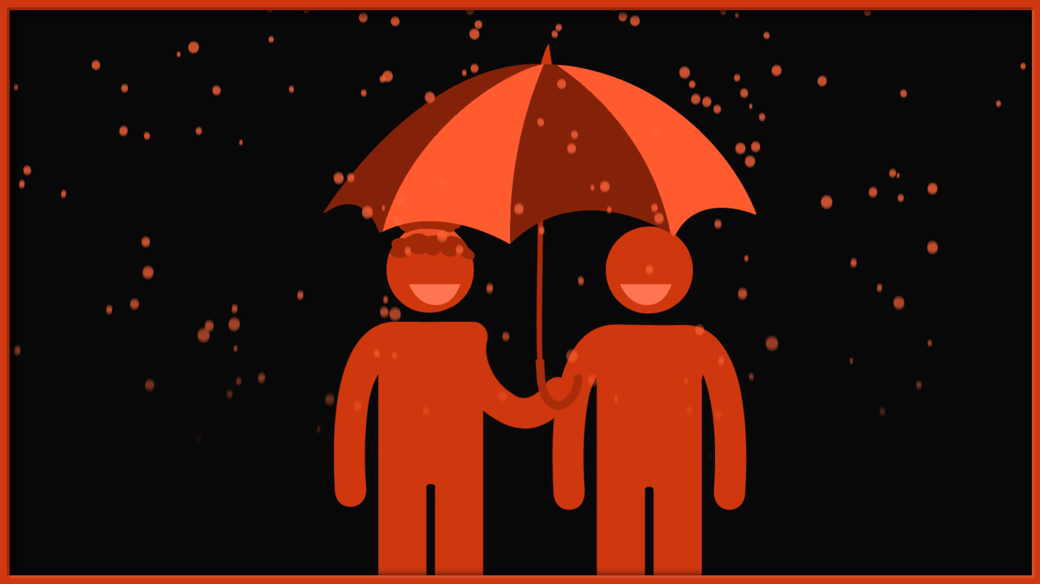
Altruism
Though we may be familiar with altruism, social psychologists are interested in understanding why it occurs.
What inspires these acts of kindness?
What motivates people to develop altruism?
Social psychologists refer to this as prosocial behavior.

Slide 30

Why do we help?
Prosocial behavior refers to any action that benefits other people, no matter what the motive or how the giver benefits from the action.
However, pure altruism involves true selflessness.
While all altruistic acts are prosocial, not all prosocial behaviors are completely altruistic.
For example, we might help others for a variety of reasons such as guilt, obligation, duty, or even for rewards.
Psychologists have suggested a number of reasons

Slide 31

Biological Reasons:
Kin selection - We may be more altruistic towards those we are related to because it increases the odds that our blood relations will survives and transmit their genes to future generations.
Neurological Reasons:
Altruism activates reward centers in the brain.
Neurobiologists have found that when engaged in an altruistic act, the pleasure centers of the brain become active.

Slide 32
Social Norms:
Society's rules, norms, and expectations can also influence whether or not people engage in altruistic behavior.
Why should you risk your own life to save a complete stranger?
The norm of reciprocity- a social expectation in which we feel pressured to help others if they have already done something for us.
For example, if your friend loaned you money a few weeks ago, you will probably feel compelled to reciprocate when he asks for a loan later.

Slide 33
Cognitive Reasons:
While the definition of altruism involves doing for others without reward, there may still be cognitive incentives that are not obvious.
For example, we might help others to relieve out own distress or because being kind to others upholds our view of ourselves as kind, empathetic people.
Some of the cognitive explanations:
Empathy: Researchers including Batson et al. (1981) suggest that people are more likely to engage in altruistic behavior when they feel empathy for the person who is in distress, a suggestion known as the empathy-altruism hypothesis.
Batson suggests that both empathy and altruism are innate traits and other researchers have found that children tend to become more altruistic as their sense of empathy develops.

Slide 34
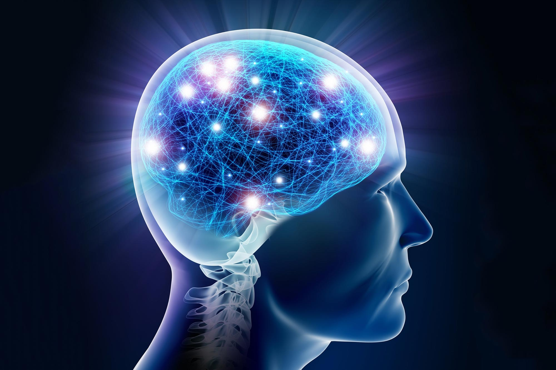
Helping Relieves Negative Feelings:
Other experts have proposed that altruistic acts help relieve the negative feelings created by observing someone else in distress, an idea referred to as the negative-state relief model.
Essentially, seeing another person in trouble causes us to feel upset, distressed, or uncomfortable, so helping the person in trouble helps reduce our own distress

Slide 35

Comparison
Comparing the Theories
The underlying reasons behind altruism as well as the question of whether there is truly such a thing as "pure" altruism are two issues hotly contested by social psychologists.
Do we ever engage in helpful actions for truly altruistic reasons, or are there hidden benefits to the self that guide our altruistic behaviors?
Batson suggests that while people do often behave altruistically for selfish reasons, he believes that true altruism is possible.
Cialdini and others have instead suggested that empathy for others is often guided by a desire to help one's self.

Slide 36

In her text Social Psychology, author Catherine A. Sanderson notes:
"Although these models may seem to contradict one another, they do agree that at times people engage in helping for egoistic reasons. The main difference between these models is that the empathy-altruism model describes the self-benefits of helping as unintended consequences, yet the negative-state relief hypothesis describes these benefits as the primary motivation for helping. What are the benefits to the self? They can be grouped into three categories: reduction of aversive arousal, fear of punishment for not helping, and desire for reward."

Slide 37

Peter Singer’s “Drowning Child”
You notice a child has fallen in and appears to be drowning. To wade in and pull the child out would be easy, but it will mean that you get your clothes wet and muddy. By the time you go home and change, you will have missed your first class.
Do you have any obligation to rescue the child?
Now imagine that the child is out in deeper water. Your risk increases. Do you still have an obligation?
Would it make any difference if the child were far away, in another country perhaps, but similarly in danger of death, and equally within your means to save, at no great cost – and absolutely no danger – to yourself?
How do you weigh the inconvenience?

Slide 38
Tragedy of the Commons
In The Tragedy of the Commons, your village has a common area of green grass. The town council just announced that anyone may graze their sheet on this common. There is no limit to how many sheep or how often you may use the common.
The common has enough grass to feed 40 sheep at a time without overloading the land.
You and 4 other sheet farmers (5 total people) each have 10 sheep (50 total).
In a perfect world, you all would set up a feeding schedule with a rotation. No one person would get more than their fair share and the common would not be overloaded.
In practice, the common is quickly overloaded as all 5 of the farmers sends all 10 of their sheep onto the land to graze. The land dies. Now, no one gets the land.

Slide 39
Tragedy of the Commons
This demonstrates egoism vs altruism.
The correct method might have been to share the field. Some of your sheep might have been hungry and it might have been more work to set up a schedule, but the green would have been maintained and everyone would have gotten grass.
What society devolved to is egoism. Their own self-interest drove the farmers to self-destruction.
How does this play out with resource extraction today?

Slide 40
DEFINITION OF REALISM
“Realism is a paradigm based on the premise that world politics is essentially and unchangeably at struggle among self-interested state for power and position under anarchy, with each competing state pursuing its own national interests” (Kegley)

Slide 41
Realism is considered the most dominant school of thought in international relations.
It is the exercise of power by states towards each and is also known as "power politics" or "real politik".
All Realists share a belief that states are unitary rational actors that are motivated by the desire for military power and security rather than ideals or ethics.
Realists view human nature as selfish, conflictual and competitive and believe that states are inherently aggressive (offensive realism) and obsessed with security (defensive realism)
Realism values order and does not welcome change (it is status quo oriented)

Slide 42
BASIC ASSUMPTIONS OF REALISM
Human Nature is imperfect and imperfect able
Human beings in order to achieve self-interest do not hesitate to destroy others when and where he gets an opportunity. Likewise countries follows
The National interest of various countries are sometime conflicting

Slide 43
Different interests can lead to war and other form of conflicts
A country’s power is crucial in determining the outcome of conflict and also to influence other countries.
Every country tries to increase its power which is fixed doctrine

Slide 44
Thus, there is contest of power going on in the world and this can neither be controlled nor regulated by international law or any international organization.
International politics, then, is aimed at increasing power, keeping power or demonstrating power.

